Slide 1
Recent Neural rendering/view synthesis advances
ML journal club 2022-07-27

Slide 2
Contents
Neural Radiance Fields
InstantNGP
Plenoxels

Slide 3
Neural Radiance Fields

Slide 4
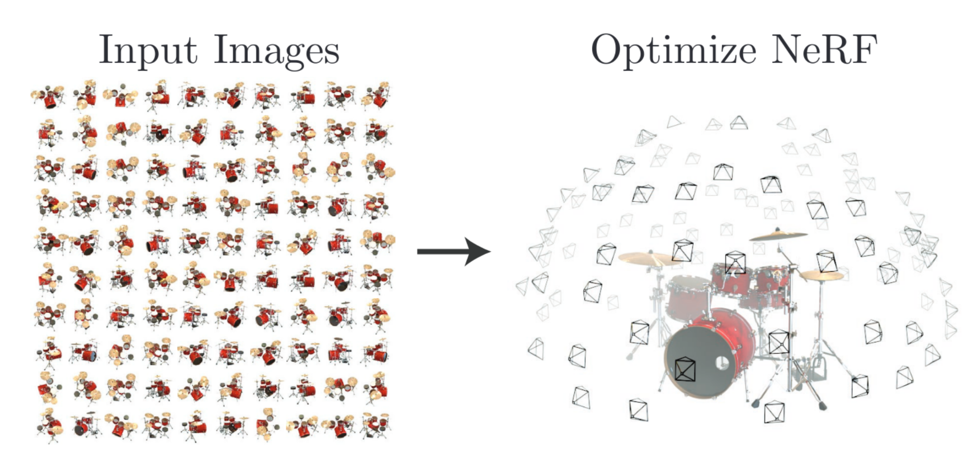
Neural Radiance Fields (NeRF)

Slide 5
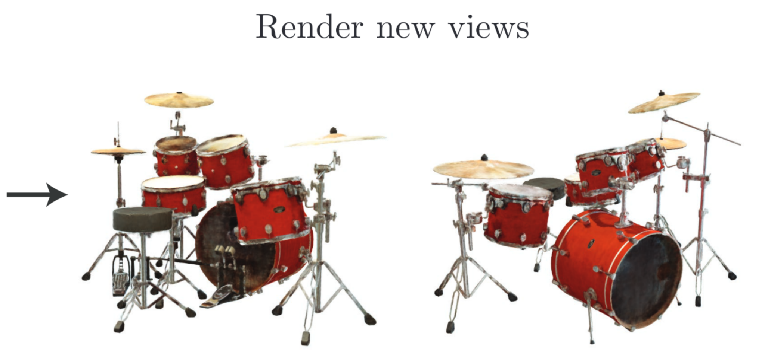

Slide 6
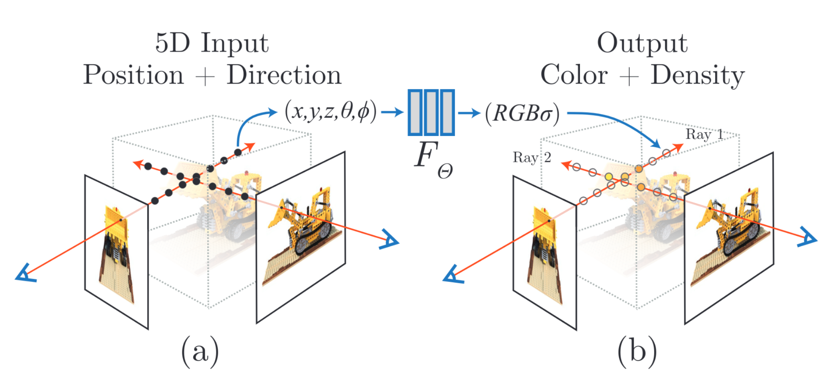

Slide 7
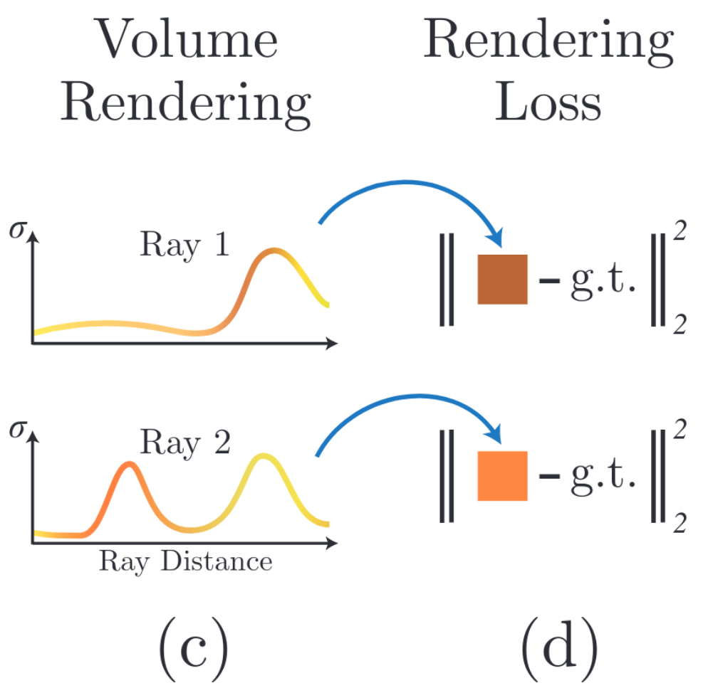
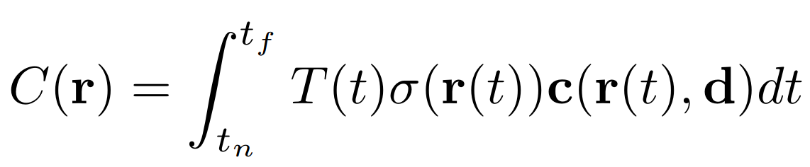
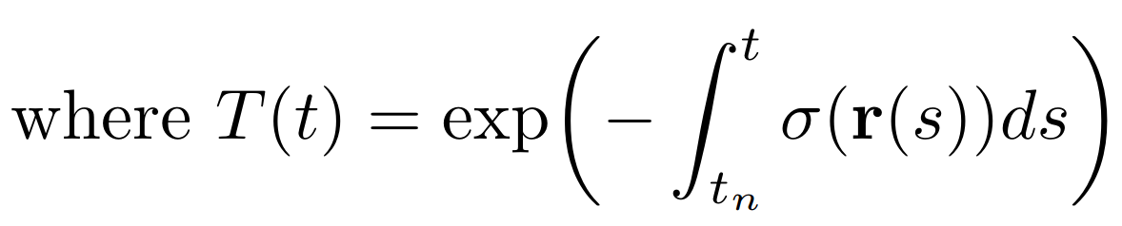

Slide 8
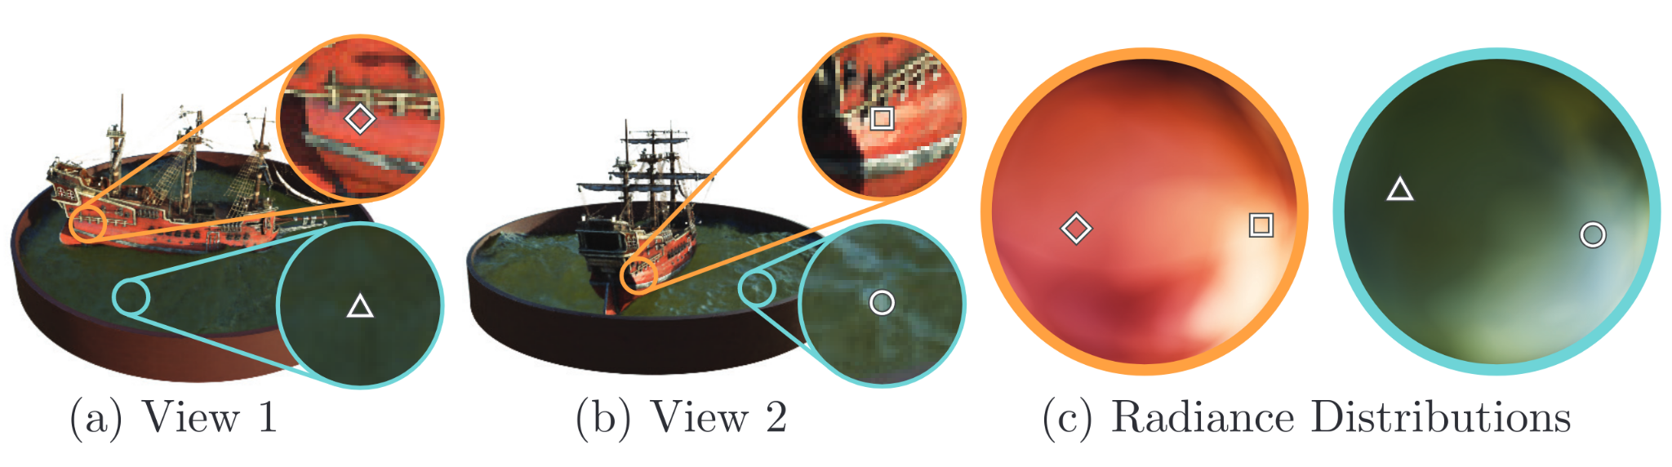

Slide 9
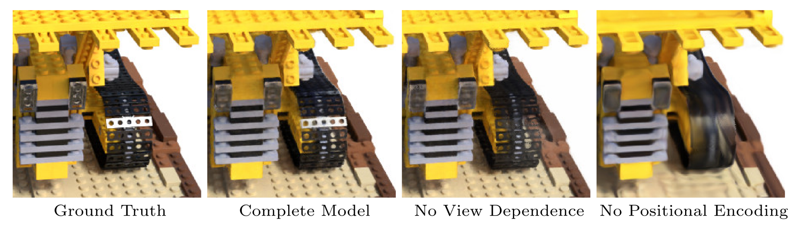

Slide 10
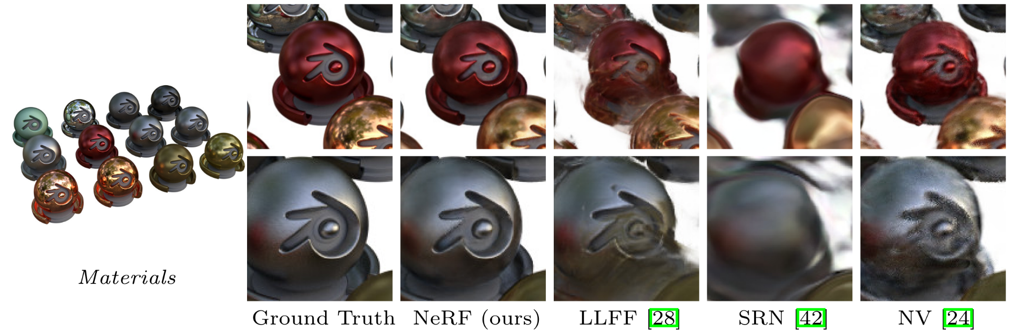

Slide 11
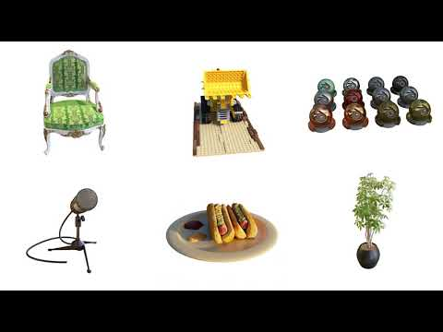

Slide 12
InstantNGP

Slide 13
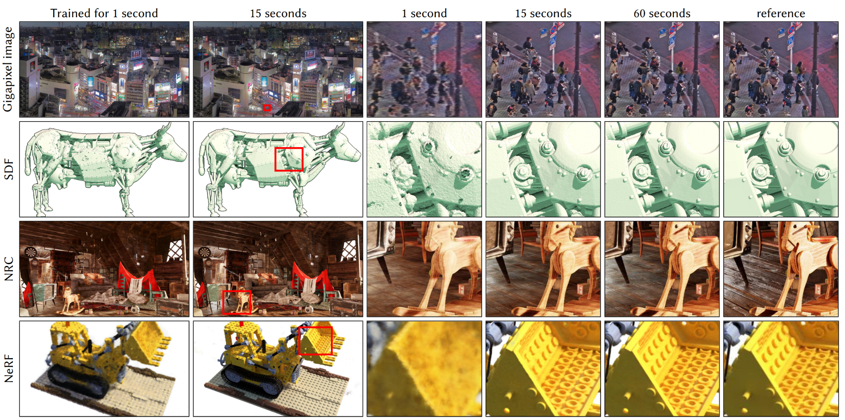
Instant Neural Graphics Primitives

Slide 14
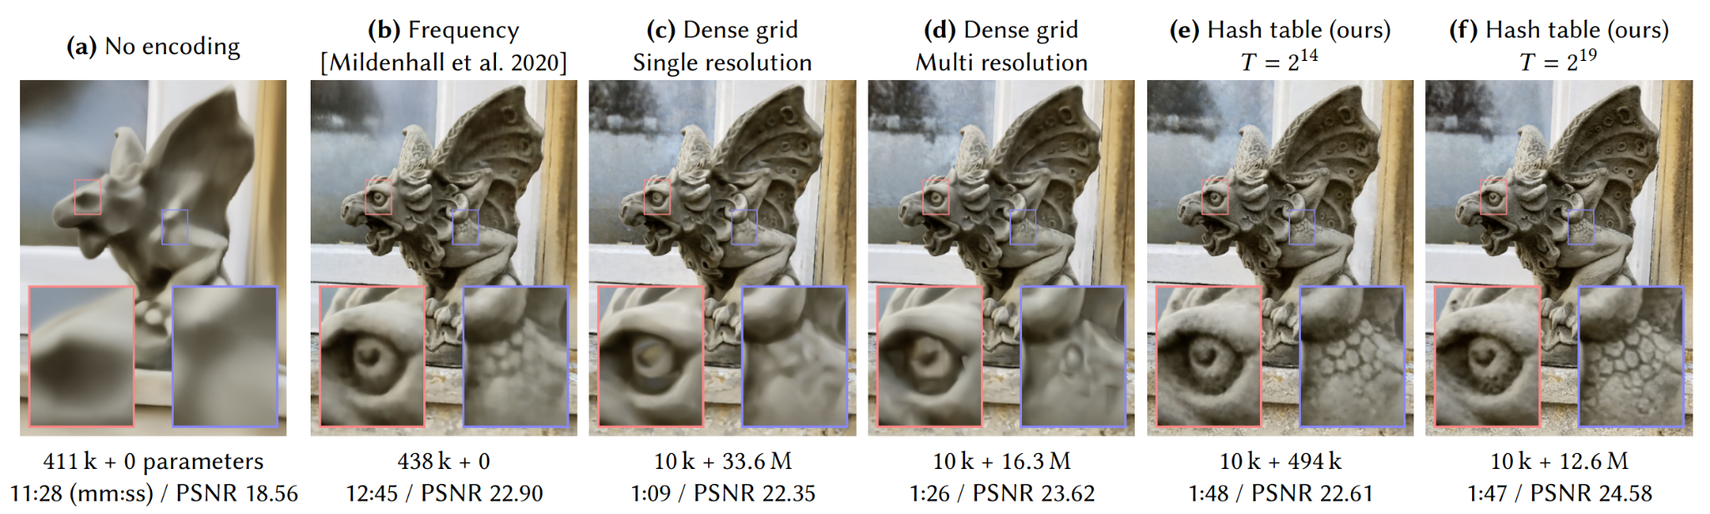

Slide 15
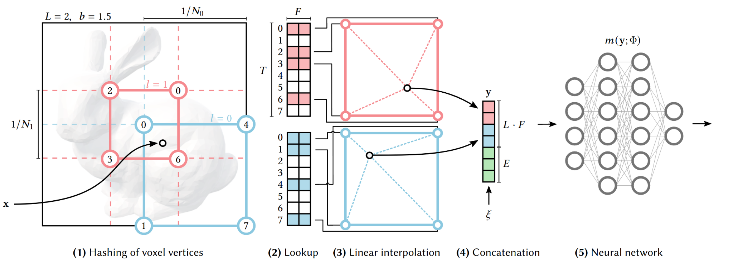
“Multiresolution hash encoding”

Slide 16
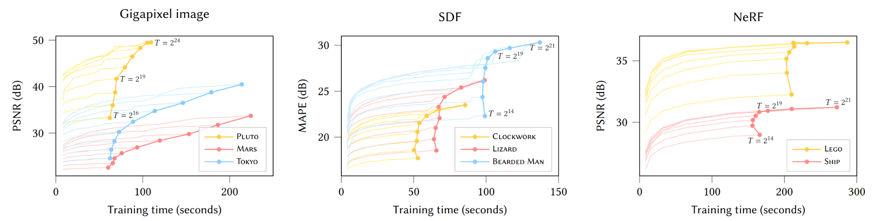

Slide 17
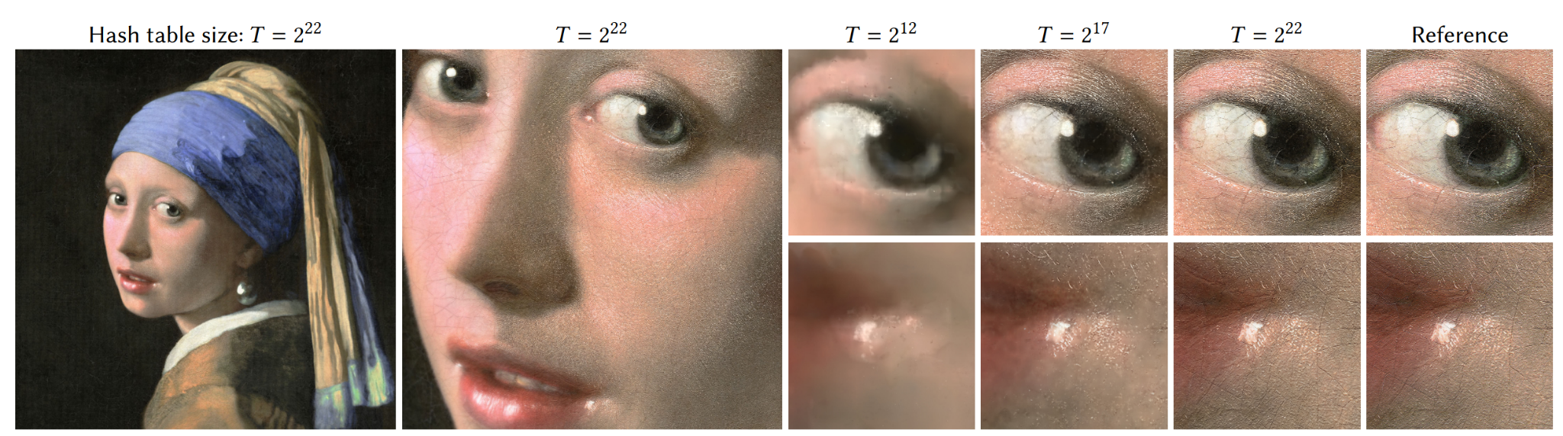

Slide 18
https://nvlabs.github.io/instant-ngp/assets/mueller2022instant.mp4

Slide 19
Plenoxels

Slide 20
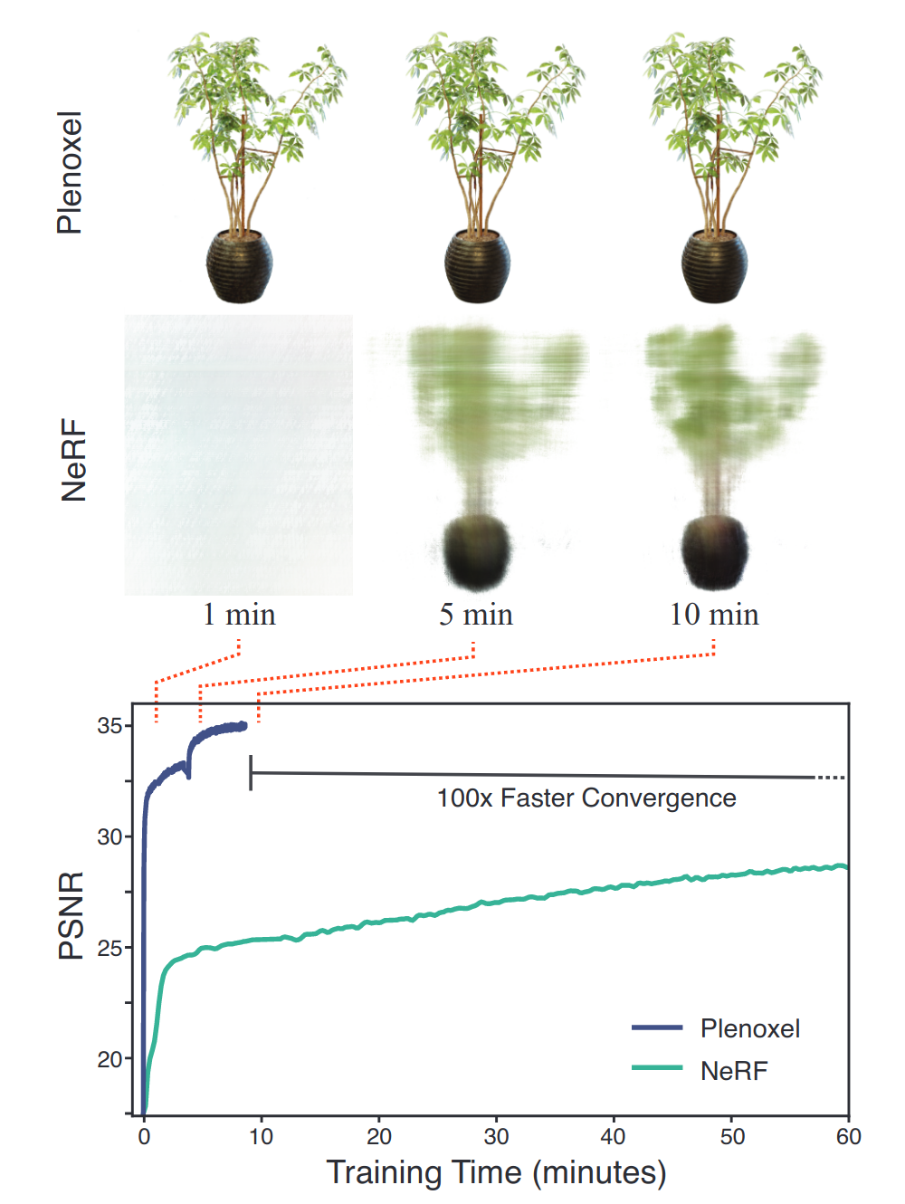
NeRF MLP not a good inductive bias

Slide 21
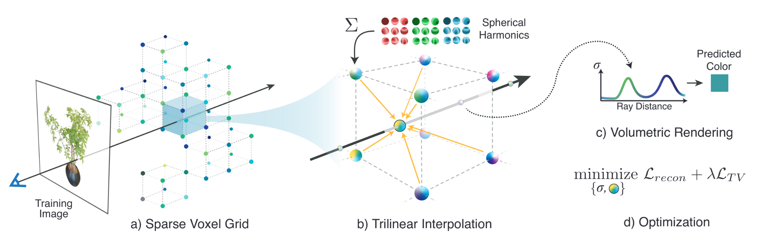

Slide 22
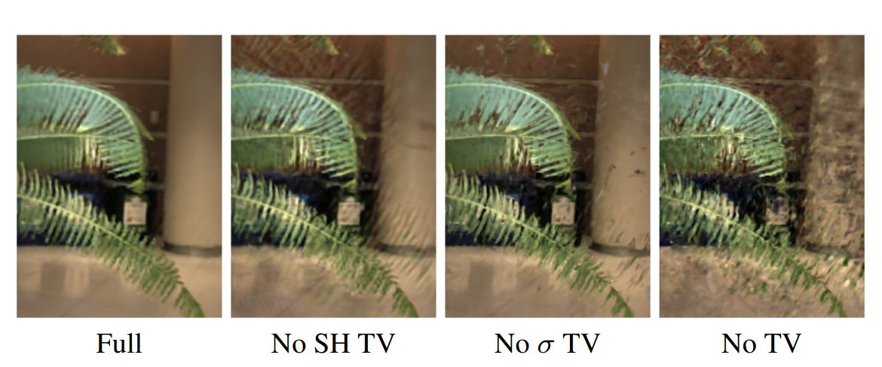

Slide 23
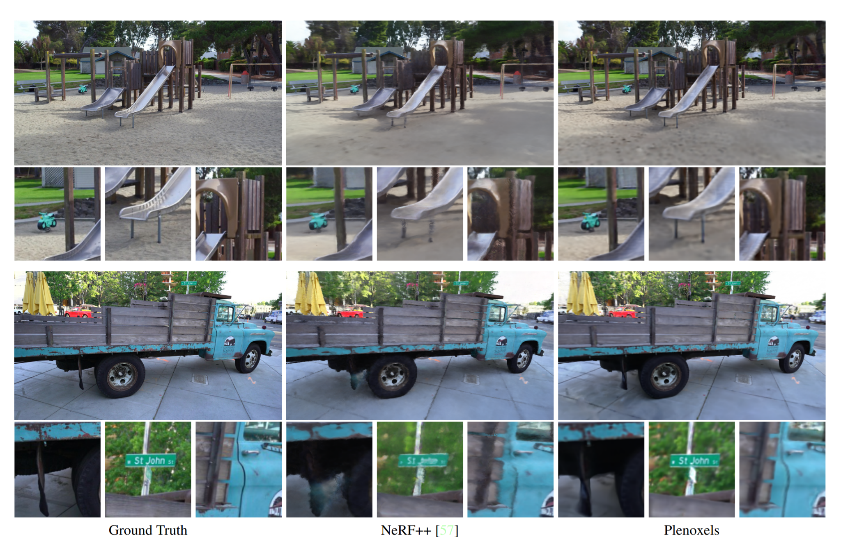

Slide 24
